Slide 1
Spring MVC Part 3

Slide 2
Delete todo is one of the most important thing we have to do. But how to tell to spring delete a particular todo.
For this we have to use Expression language. So that we can dynamically take the input from jsp. Also mention @RequestParam in controller method to receive the input to out controller method(deleteTodo() method).
<a href="/delete-todo?id=${todo.id}" class="btn btn-danger">Delete</a>
@RequestMapping(value="/delete-todo",method=RequestMethod.GET)
public String deleteTodo(ModelMap model, @RequestParam int id){
service.deleteTodo(id);
model.clear();
return "redirect:list-todos"; }

Slide 3
If we have four todos , we want to delete one todo, by the time we click on particular todo, the corresponding id is passed to controller method.(used expression language to take input dynamically aslo using @RequestParam annotation for id in controller method to receive that dynamic input, from the jsp while we are trying to delete that particular todo. )
So the controller will understand which todo I need to delete, and it will delete that particular todo.

Slide 4
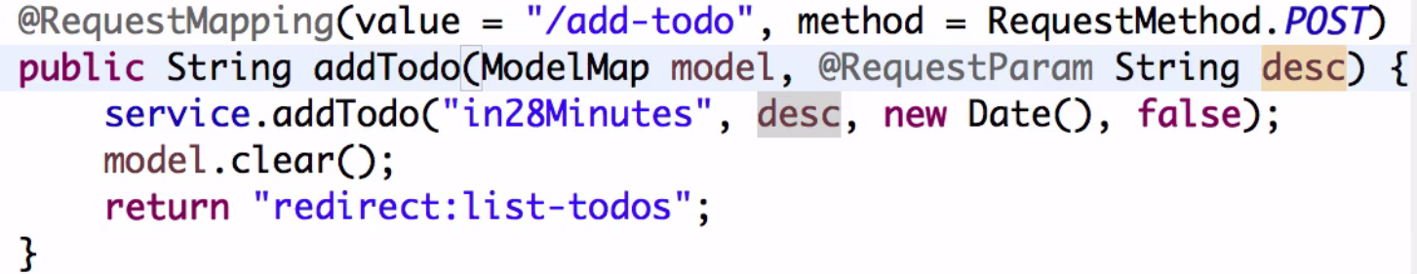
Here we are typing each filed as a request, If we need desc, then we have bind it to the description field. Or I f we want to bind as id I need to add request param for Id. The same for any other field if we want to use. If we want to use many fields, we have bind them all.
It is not a better practice, instead of binding one by one, I would directly bind to CommandObject. For example the object name is todo, we simply get the parameter by using todo.getDesc(); . Also we can get all the parameters in the command object in the same way.
If we want to make use of CommandObject we have to use spring framework tags in the corresponding jsp also. Also need to use spring form tag.(in todo.jsp)
<%@taglib uri="http://www.springframework.org/tags/form" prefix="form"%>

Slide 5
Instead of using normal <form> tag, use <form:form> tag in the jsp.
Hibernate validations:
To apply validations to the bean(Todo) we have to use Bean Validation API.
If we want to validate size, use @Size it is avaikable javax Validations, it have attributes like min, max. So we can define min or max no of characters for a field.
@Size(min=6, “At least enter minimum 6 characters” ) , it means the field is less than 6 characters it will display the above error.
What ever the validations we use it is a part of javax.validation.contraints, but we don’t have implementation for this validations. If we want to get the implementation we have to use hibernate validator.
To use this implementation we need a jar, we have to add this hibernatevalidator. jar in pom.xml

Slide 6
Now I want to apply the validations while the user is trying to add a new todo.
For that we need to use @Valid annotation in addTodo POST method. So when ever user adding new todo, this validations were applied to that new todo.
Also when ever we are using @Valid annotation , we have to use “BindingResult result” . When ever we perform validations we get some results from it.
So in order to access those results we have to use BindingResult, also if any error occurred while performing validations, that are put into BindingResult.
Use result.hasError() method, so if there is an error we will redirect to todo.jsp with error message, where all list of todo were present.

Slide 7
If we want to display the error message , we need to use <form:errors> element otherwise the error message would not be displayed in the web page, even though we got the error.
If there is no error we will redirect to todo.jsp, where all list of todo were present.
If we want to update a todo we no need new jsp, instead we add some changes to todo.jsp and we will make use of it.
Once we have CommandObject , we can use it for updating , deleting, etc. For now we use CommandObject to provide update functionality to our existing todo.
Till now we don’t have a retrieve todo based on id, So we create this method in TodoService.

Slide 8
After Successfully updating todo, we are not getting the targetDate. We will try to fix it later. For now the update to is working fine.
We should not use hidden variables always. Hidden variables are the part of post, anybody can see and intercept those variables. Also can able to change them.
So we should put very few parameters in hidden parameters. We can put id in there, but if we put user or some confidential data then it will be a security problem. Hackers can change the username and todo will stored against that particular user.
So instead of taking the data from the form , we take it from session. For that use use ModelMap in the method also we will hardcode the user name. like todo.setUser("in28Minutes");M

Slide 9
@InitBinder
In order to make the date looks better, we can ues jstl formatdate tags <fmt:formatDate pattern="dd/MM/yyyy" value="${todo.targetDate}"/>
, we also define the format like : dd/MM/yyyy.
To use this format date, we need to add a tag library in list-todos.jsp
<%@ taglib uri="http://java.sun.com/jsp/jstl/fmt" prefix="fmt" %>
Navigation to our jsp :
We will use classes like navbar, navbar-default, to provide navigation to our list-todo.jsp
navbar-brand : It is a class for Displaying brand of company, etc
navbar-nav : class to display values in horizontal line.
active : To highlight a particular value, in web page.

Slide 10
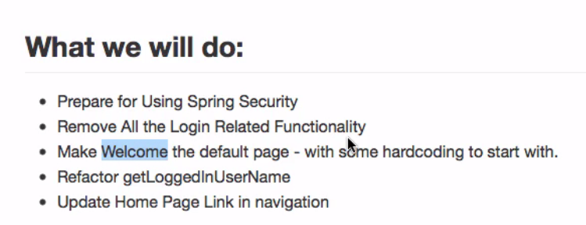
JSP fragments
To maintain code clear and easy readable we use jsp fragments, it contain extension .jspf
We put header related code in header.jspf, navigation re;ated code in navigation.jspf, and footer related code in footer.jspf
Once we defined these three things for one jsp, we can also use these for other jsp’s also.
For reftracting the user name from
“in28minytes” to retrieveLoggedinuserName()
In listTodos-GET method , in TodoController
class

Slide 11
Adding Spring Security
Need to use 2 jars, spring-security-web and spring-security-config in pom.xml
Need to add SecurityConfiguration class
Also need to add filters, SpringSecurityFilterChain
In javaEE we intercepts every request by using filter, But here in spring mvc we use springSecurityFilterChain. What this filter will do, It makes the request first go to SpringSecurity. If no user logged in then the user automatically be sent to login page.
SpringConfiguration class contains, two thigs who are valid users and his pw’s, and His roles(“user” or “admin”).
In any one logged in with valid user name and password, we will give them the access and will give the roles also like user or admin. If he is invalid user we send him back to login page.
We can add as many user we want in this class.

Slide 12
We are securing the url here, if any request like /todo we have to make it secure. We will only allow them if he is user or admin and will send to todo page, otherwise will send back the him to login page.
We already removed our login.jsp, but how we can send them to log page. ???. Magic is spring security has its own login page to provide security, to out todos, “/login” we use as a link for login page.
Anyone is trying to login , first they sent to this login page.
For filters, : any request like “/*” ->SpringSecurity->Dispatcherservlet
Before we added Spring Security functionality, we can goto any page we want like , welcome, todo.jsp, but after adding this feature we can’t access the todos page without logging in. If we enter valid credentials then only we will redirect to todo webpage otherwise not.

Slide 13
Adding log out functionality :
Principle is basically a user who is logged in, we call it as Principle in security systems.
Need to use logout controller class, inside the logout method , we need to check the user’s session is timed out or not , if time is up we need to send the user to login page.
To validate, we use request.getSession().invalidate(); method.
When the use clicked on logout , we just redirect him to login page.

Slide 14
Exception handling is called a cross cutting concern. If we want to do exception handling for data layer, business layer, or irrespective of any layer then we call it as cross cutting concern.
Don’t try to handle all the exceptions, just understand why he is getting the error, and show that validation to th user.
@ControllerAdvice, the annotation that what ever the code we put in this perticular controller, it is applicable to all controllers in the project.
Or if we want to handle specifically, we use Controller specific Exception handling. When we get any exception we call logger.error() method, and we show the error page.
Also we will create a error.jsp page , to display the error when ever we get an exception. And we use @ExceptionHandler annotation on top of handle exception method. So that this method is recognized as a Excetion handler. And this ExceptionController is generic.
If we want to perform specific Exception handling, we have to create a error specific page, looger in that class and redirect to that page,M for this we have to use handle exception method in the specified class.
if we get error in any jsp, then the entire app’n will not work to overcome this we use <error-page> element in web.xml

Slide 15
Internationalization
Internationalization means When the user want to see the application in different languages, the entire application need to customized into their specific language.
For this we need to use, <bean id="messageSource" />, <bean id="localeResolver“/>, <mvc:interceptors><,mvc:interceptors> in todo-servlet.xml.
Also need to create messages_en.prop, messages_fr.prop properties files in src/main/resources- folder to show the messages in english or in french.

Slide 16
Spring Web Services
The Rest services that we are creating will have a json i/p and json o/p.
The use of this services is when the user enter the todos in the url , we will display those todos in the url.
Need to create a class TodoRestController, also need converter called jackson for add a dependency in pom.xml
If we have 4 todos, want to get todo of id = 1, we also get a specific todo also for this
@RequestMapping(path="/todos/{id}")
public Todo retrieveTodo(@PathVariable int id){
return service.retrieveTodo(id); } - need to give dynamic id and @PathVariable annotation

